Slide 1
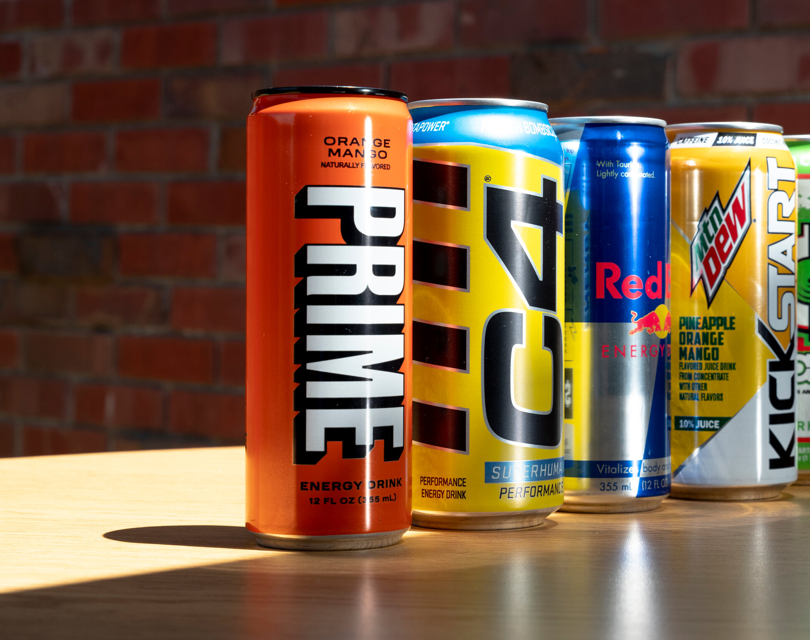
Energy Drinks
The Rise does not allow students to bring or consume energy drinks.
Why?
Energy drinks are high in caffeine which gives a temporary 'high', followed by extreme 'low' or 'crash' in mood
This short-term high causes disruption to concentration, making learning more difficult
Energy drinks are intended often to boost sports performance and were not intended to be marketed at young people
UK government suggests no-one under 16 should consume these

Slide 2
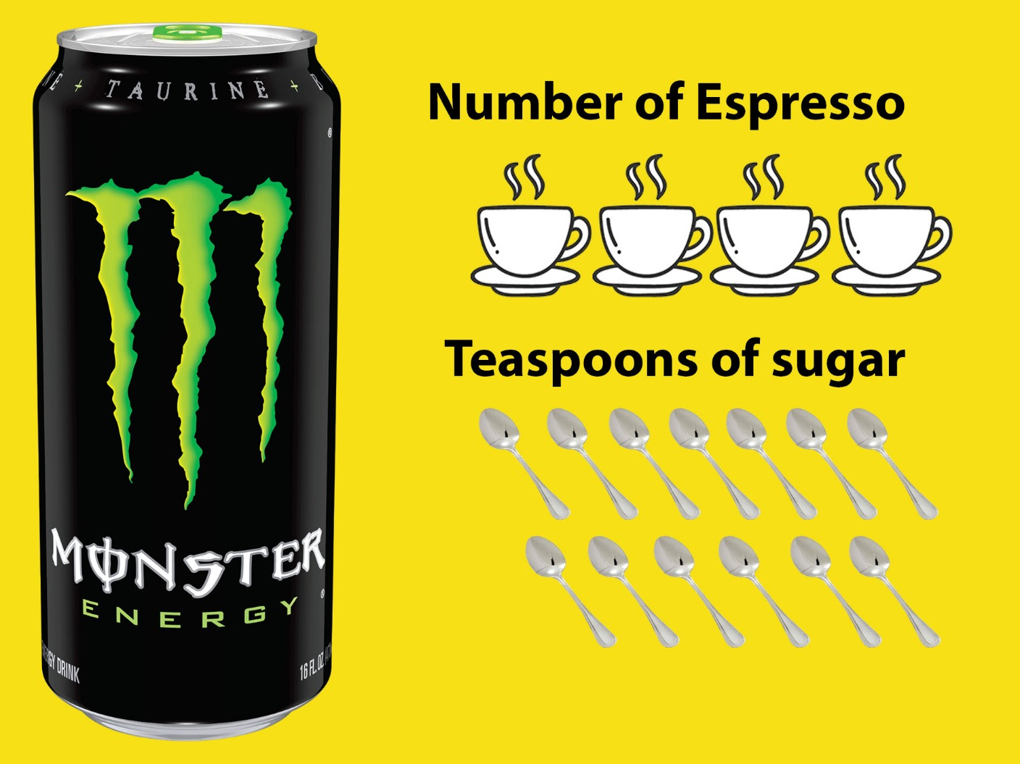
Energy Drinks
Why?
Energy drinks are high in caffeine which gives a temporary 'high', followed by extreme 'low' or 'crash' in mood
This short-term high causes disruption to concentration, making learning more difficult
Energy drinks are intended often to boost sports performance and were not intended to be marketed at young people
UK government suggests no-one under 16 should consume these

Slide 3
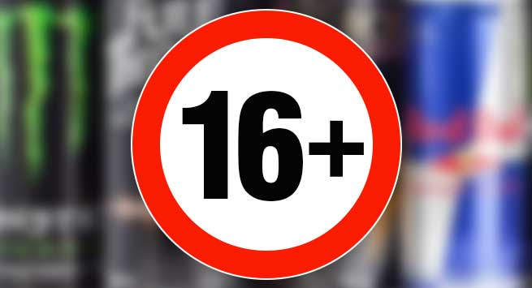
Energy Drinks
What happens if I bring these to school?
Unhealthy foods and drinks including energy drinks will be confiscated by an adult
This is also the case for other forms of contraband which may be unsafe, electronic or inappropriate to learning
(Specifically Energy or unhealthy drinks/snacks)
Strike 1: The first time an adult will give you a warning, confiscate the drink till home time and then return it to you at 3pm, parents will be contacted and you will be asked to not bring it to school again
Strike 2: Anything after this will be a permanent confiscation which items will not be returned

